Slide 1

How do Organisms
Reproduce?
Need for contraception
Methods of contraception
Reproductive health and healthy society

Slide 2

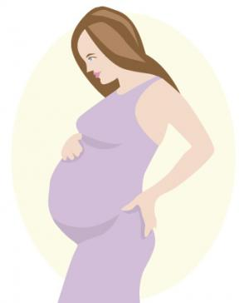

Reproductive health
The sexual act always has the potential to lead to pregnancy.

Slide 3
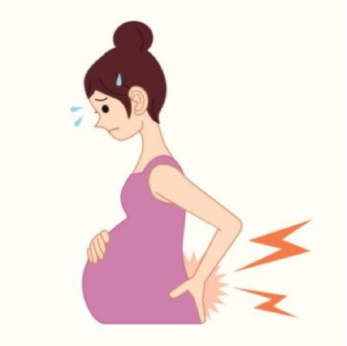
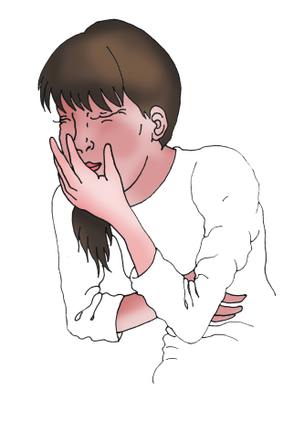
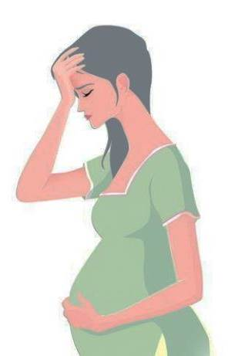
Reproductive health
Pregnancy will make major demands on the body and the mind of the woman,
Weakness
Nausea
Stress
and if she is not ready for it, her health will be adversely affected.

Slide 4
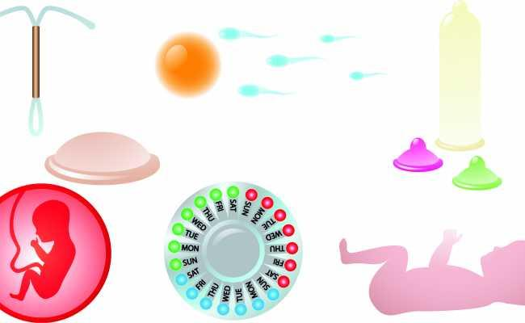
Reproductive health
Therefore, many ways have been devised to avoid pregnancy.
These methods or ways are called as ‘contraceptive methods’ or ‘ methods of birth control’.

Slide 5

Reproductive health
These ‘contraceptive methods’
have number of categories (based on their approaches).

Slide 6

Reproductive health
One category is the creation of a mechanical barrier so that sperm does not reach the egg.
This method is called as ‘barrier method’.

Slide 7
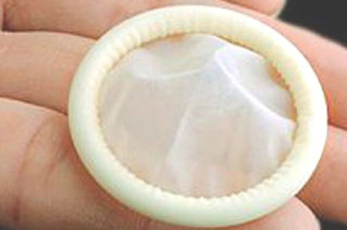
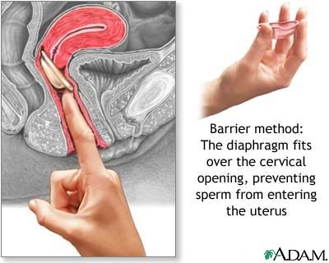
Reproductive health
Methods of birth control
Barrier
In males
In females
Condom
Diaphragm
Protects from STDs
(Prevent the entry of Sperms)

Slide 8
Reproductive health
Another category of contraceptives acts by changing the hormonal balance of the body so that eggs are not released and fertilisation cannot occur.
This method is called as
‘Chemical method’.

Slide 9

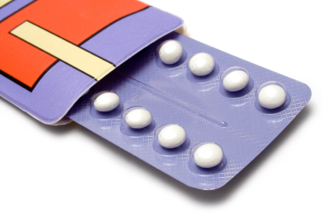
Reproductive health
Methods of birth control
However, since they change hormonal balances, they can cause side-effects too.
Barrier
Chemical
Oral pills
These drugs commonly need to be taken orally (by females) as pills.

Slide 10
Reproductive health
Other contraceptive devices such as…..

Slide 11
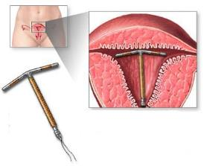
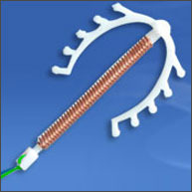
Reproductive health
Methods of birth control
Barrier
Chemical
Other
IUCD
The Copper-T
The loop
Again, they can cause side effects due to irritation of the uterus.
Intra - Uterine Contraceptive Device

Slide 12
Reproductive health
Another approach to contraception is to avoid fertilization by blocking the paths of the male and the female gametes.
Such methods are called as
‘Surgical methods’.

Slide 13
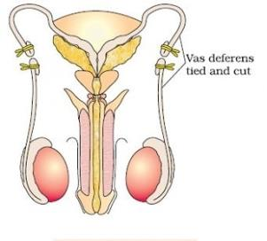
Reproductive health
Methods of birth control
Barrier
Chemical
Other
Surgical
Male
Vasectomy
Removal of small portion of Vas deferens
If the vas deferens in the male is blocked, sperm transfer will be prevented and fertilisation will not take place.

Slide 14

Reproductive health
Methods of birth control
Barrier
Chemical
Other
Surgical
Female
Tubectomy
Removal of small portion of fallopian tube or oviduct
If the fallopian tube in the female is blocked, the egg will not be able to reach the uterus and fertilisation will not take place.

Slide 15

Reproductive health
While surgical methods are safe in the long run, surgery itself can cause infections and other problems if not performed properly.

Slide 16
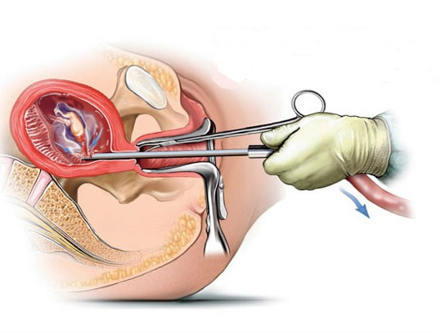
Reproductive health
Surgery can also be used for removal of unwanted pregnancies.

Slide 17

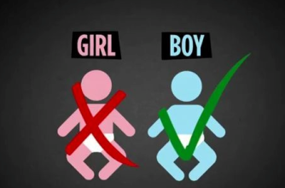

Reproductive health
Such surgeries may be misused by people who do not want a particular child,
as happens in illegal sex-selective abortion of female foetuses.

Slide 18
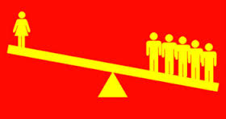
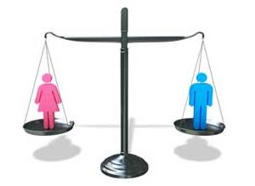
Reproductive health
For a healthy society – Female-male sex ratio must be maintained.

Slide 19
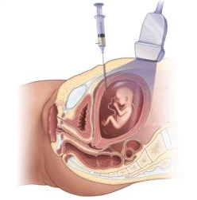
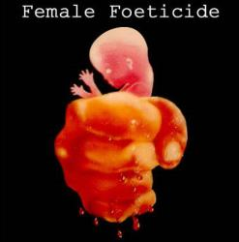
Reproductive health
Because of reckless female foeticides, child sex ratio is declining at an alarming rate.
Illegal the killing of a fetus

Slide 20
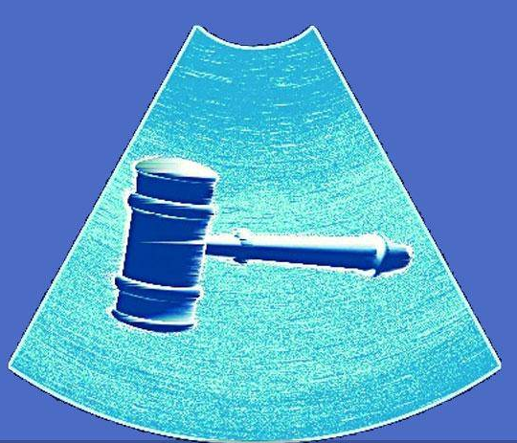
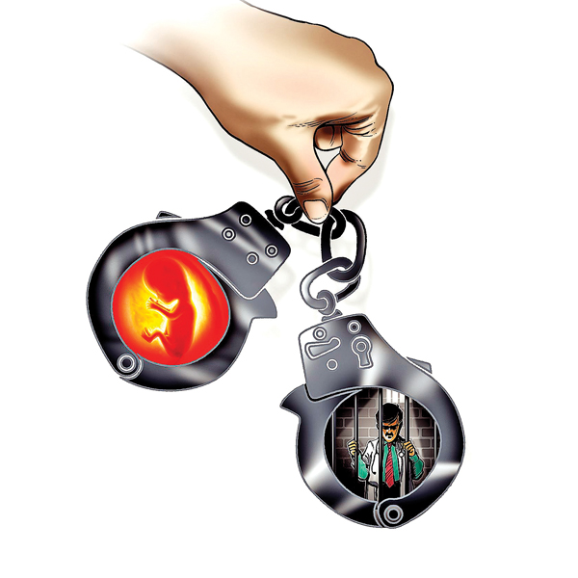
Reproductive health
Prenatal sex determination has been prohibited by law.

Slide 21

Reproductive health
Human population has to be controlled.

Slide 22
Thank You

